Slide 1
Film Production
Molly.gardner09@gmail.com

Slide 2
What is a story?
  A person encountering obstacles in pursuit of something they want.
  Example: A man with a debilitating stutter prepares for a date with the girl of his dreams.
  Express your unique worldview
  With a short film - jump into the story right away and keep it simple.
  Irony – use irony to explore different points of view.
  Situational Irony – A police car is robbed.
  Dramatic Irony – The audience knows more than the character.
    Suspense = Expecting something to happen that doesn’t yet.
    Surprise = Something happens that you don’t expect.

Slide 3
Pre-Production
Brainstorm story ideas, locations and characters.
  You must be able to explain your story in 1 cohesive sentence.
Outline – A document that lists the plot (the series of events in the story)
Script – A document broken up into scenes with location, action and dialog.
Shot List – A list of shots per scene.
  Plan out angles, cut-aways, establishing shots, voice-overs, etc. Think forwards to the editing process.
  Long Shot, Medium Shot, Close Up
  180 Degree Rule
  Prepare for the shoot - Bring the above documents, release forms, charge the camera, format the SD card

Slide 4
Production
Video - Show don’t tell: Dialog is important but SHOW the audience information instead of having a character TELL them.
Audio – The most important part of your shoot! Check your levels on the camera and wear headphones.
Lighting – Work with your available light. Outdoor sunlight is always a nice choice. Take advantage of windows inside but don’t film directly into them.
Camera Placement/Movement – Angles, Perspective and Movement all influence the film’s look and emotional impact. The audience views the story through your lens. What do you want them to see? And from what perspective? How do you want them to feel?

Slide 5
Camera Setup
How to format the SD Card.
  Press arrows on screen until menu button comes on.
  Click Setup in Menu.
  Scroll until you see FORMAT MEDIA
  Do you want to format card? Click Yes. (This will erase all content on the card.)
  Formatting card will erase all contents. Do you want to continue? Click Yes.

Slide 6
Camera Setup
Turn ON/OFF Camera Light
  Press arrows on screen until menu button comes on.
  Click Record Setup in Menu.
  Scroll until you see Video Light.
  Click ON or OFF
Video Record Settings
  Press arrows on screen until menu button comes on.
  Click Record Setup in Menu.
  Click REC FORMAT
  Choose MP4/iFrame (Don’t exit menu)
  Click REC MODE
  Choose 1080 MP4 28M

Slide 7
Camera Setup
Audio Levels
  Wear headphones and watch the levels on the bottom of the screen. There should be several white lines but if you see red lines the audio is too loud. If you need to make adjustments:
  Press arrows on screen until menu button comes on.
  Click Record Setup in Menu.
  Scroll until you see Mic Level.
  Click SET AGC ON.
  Using the arrows increase or decrease the microphone levels.

Slide 8
Post-Production
Music – Use stock/royalty free music if you decide to use music.
Use effects, titles and transitions to serve your story. Consider the tone of your piece.
Color Correct – correct inconsistencies in color and lighting
Audio levels – Again, the most important part! Make sure dialog and/or voice-overs are consistent and clear.

Slide 9
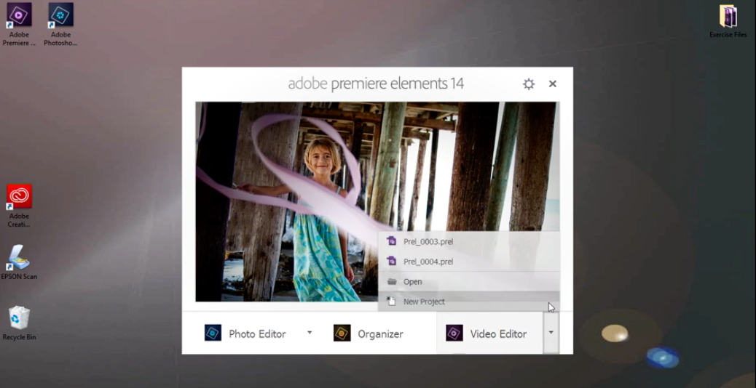
Premiere Elements

Slide 10
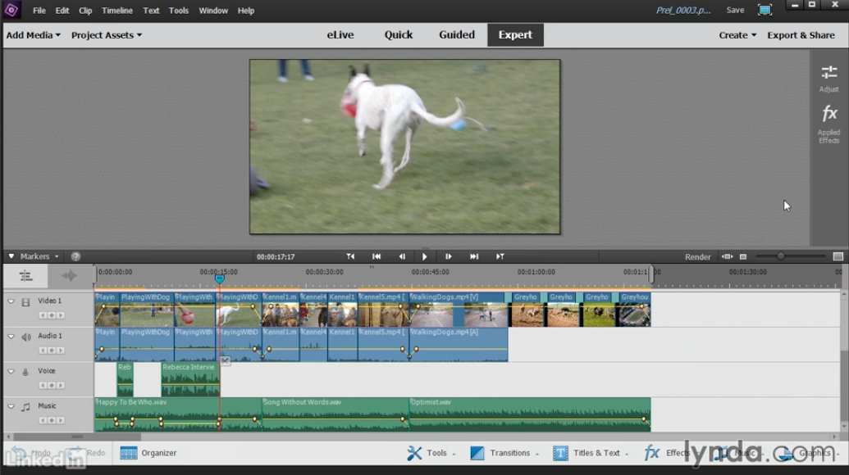
Choose Expert Workspace

Slide 11
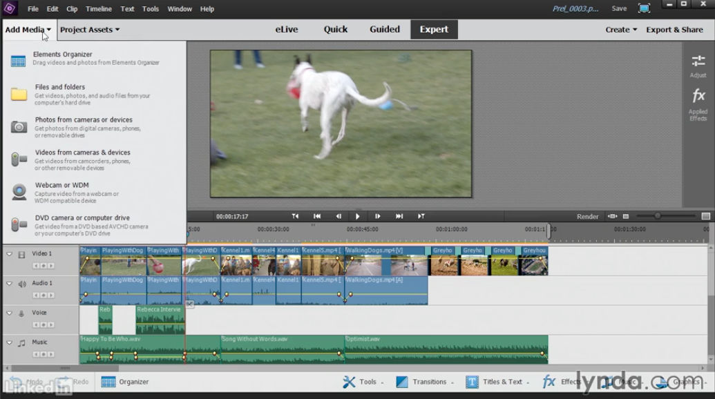

Slide 12
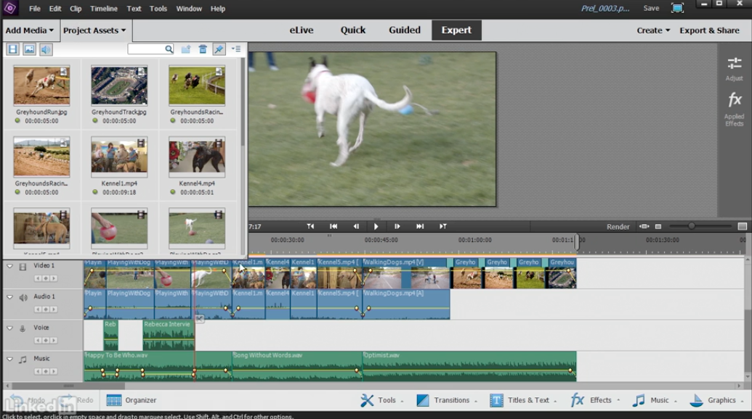

Slide 13
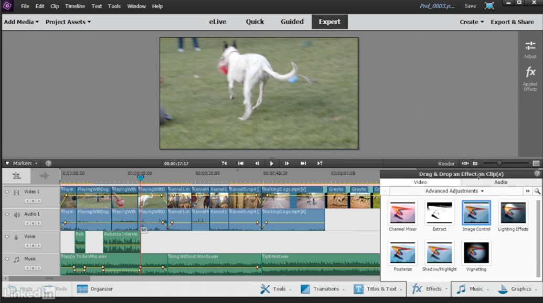

Slide 14
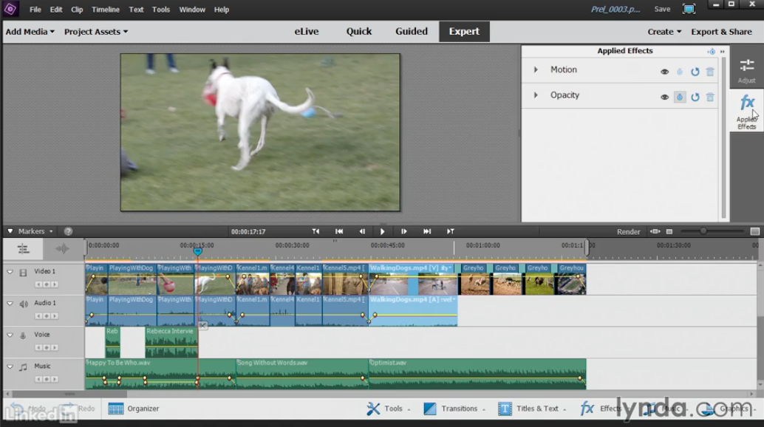

Slide 15
