Slide 1
Smart Grid stories
A Tale Told in 3 Parts

Slide 2
Chapter 1. How It All Started

Slide 3
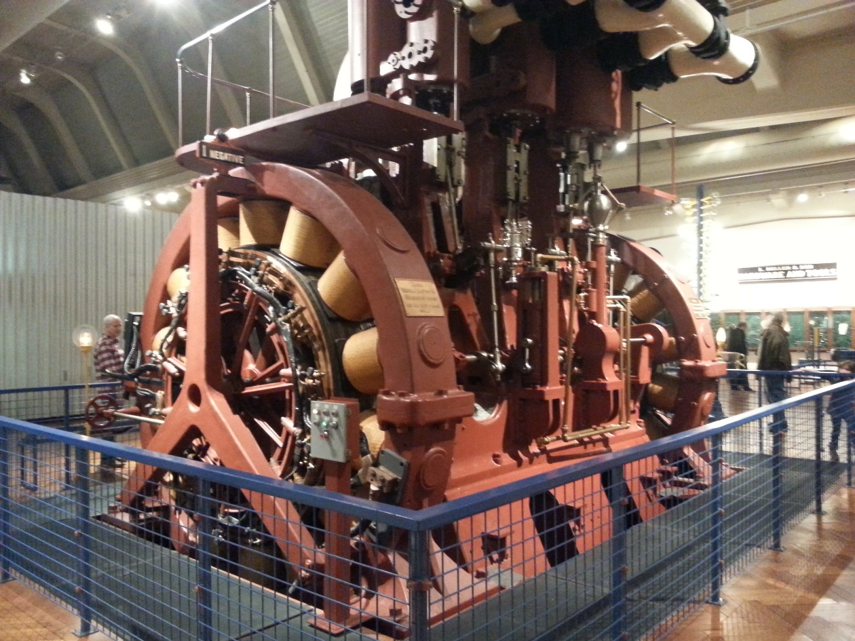
Early Days of Electricity
Electricity arrived in DuPage around 1900
Usually small local power plants
DC power meant short wires
Wealthy people had their own private
power plants
Power plants run for limited periods

Slide 4
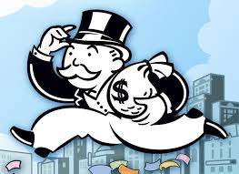
Enter Sam Insull

Slide 5
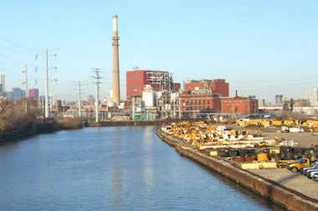
Sam’s Brilliant Idea
Use AC power – not DC
Large central power plants
String wires long distances
Buy out the competition
Be a regulated monopoly
Founded ComEd

Slide 6
What We Have Now

Slide 7
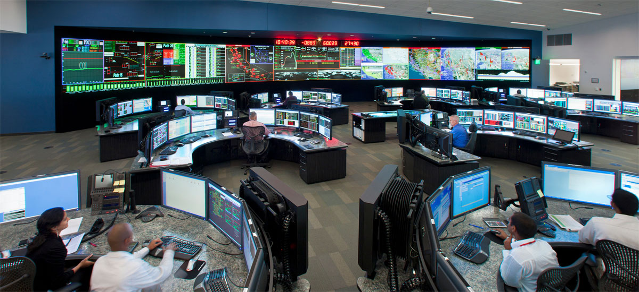
Power Demand = Supply
Then and now - little or no storage
It’s there when you ask for it
This creates vulnerability

Slide 8
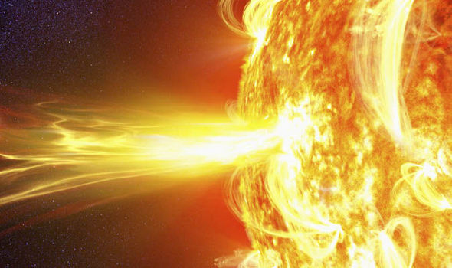
What is the greatest threat to the electrical grid?
Trees?
Terrorism?
Internet hacking?
Squirrels?
Solar flares?
High demand?

Slide 9
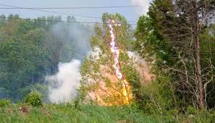
Answer: Squirrels and trees!

Slide 10
The Exploding Tree
https://www.youtube.com/watch?v=2gkBlDQ1NR0

Slide 11
Chapter 2. What happened on August 14, 2003?

Slide 12
The Blackout of 2003

Slide 13
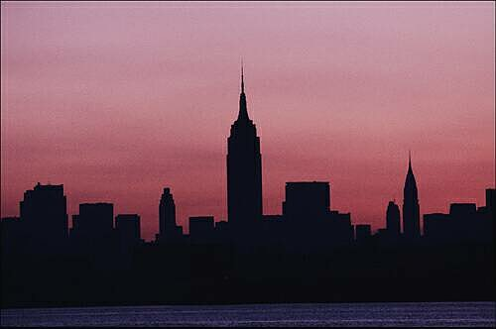
Impact of Blackout
55 millions of customers with no electricity from Michigan to New York City to Toronto
Subways in NYC not working
Cleveland has no public water
No lights or air conditioning for up to
2 days
Raw sewage dumped into waterways
Ontario declares a state of emergency
Economic damage - $6 billion

Slide 14
How Could This Happen?
Hot summer day
Sagging power lines touched a tree near Akron, Ohio
Transmission lines knocked out
Demand and supply out of balance
First Energy had no idea! (software bug)
Power plants taken off line
Cascading failure - lights out by 4 pm!

Slide 15
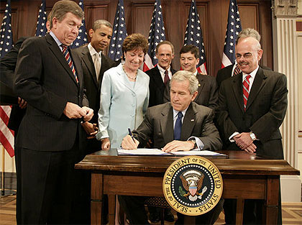
America Responds
Energy Policy Act of 2005
Commitment to modernize
the electrical grid
Introduced new technologies

Slide 16
Chapter 3. The Modern Energy Consumer

Slide 18
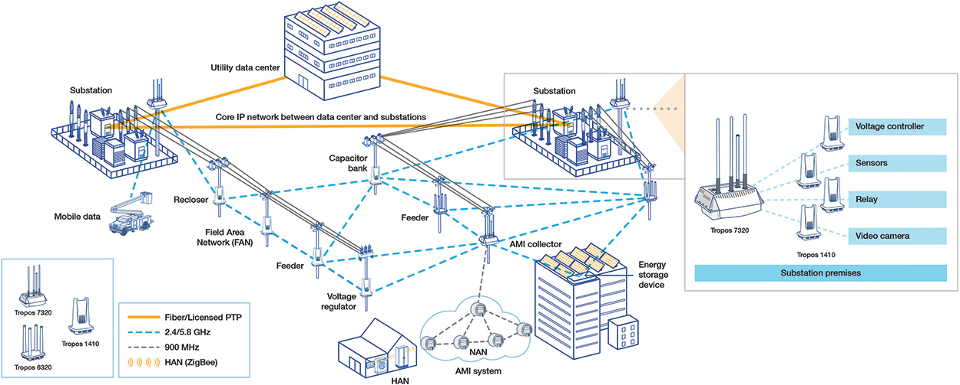
Advantages of the Smart Grid
Reliability – self healing at computer speed
More information – detect and notify
Faster repair times for repair crews
Better at balancing demand and supply
More flexible for adding solar and distributed generation

Slide 19
Enter Smart Meters. So What Are They?

Slide 20
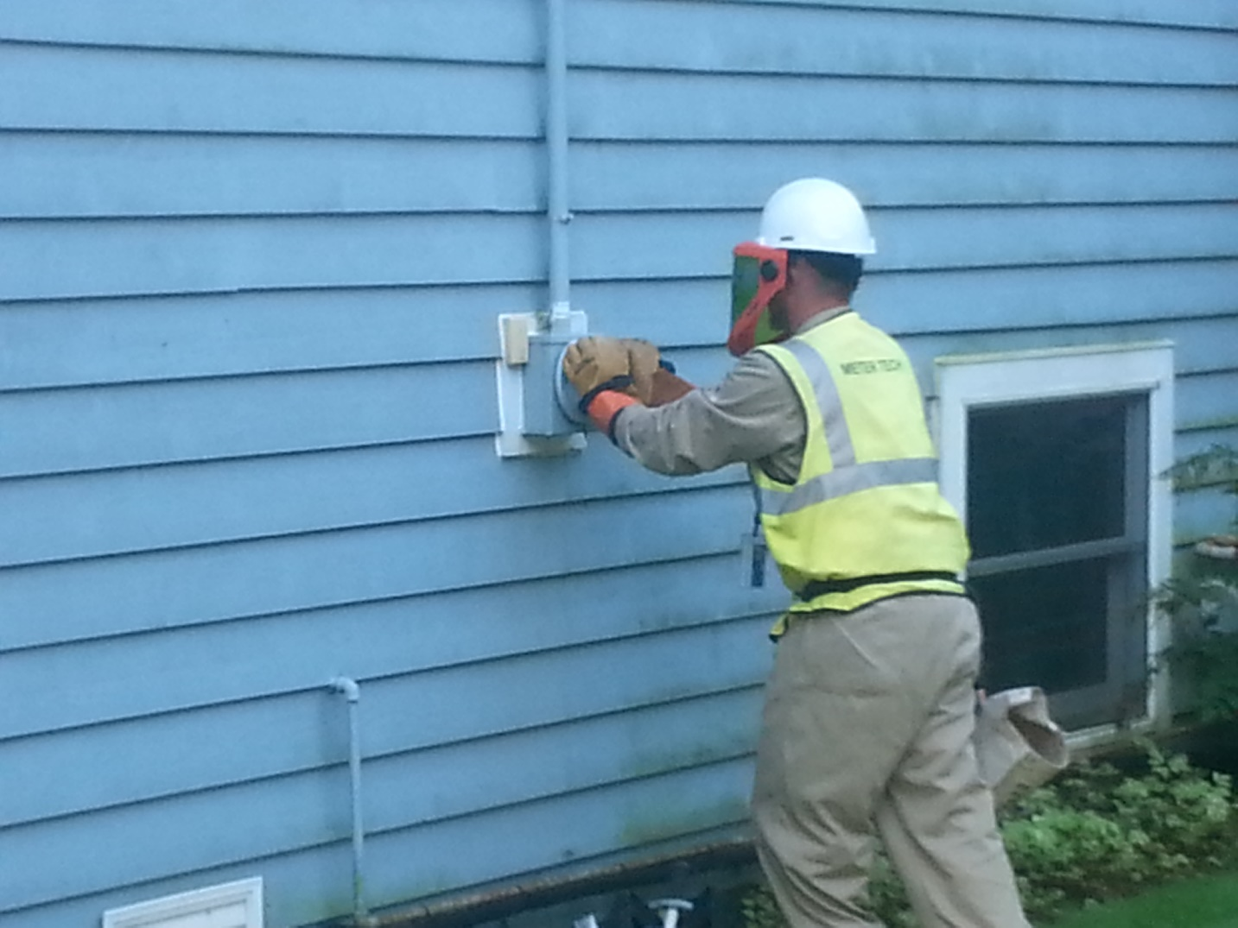
Value of Smart Meters
Notify us of outages
ComEd can text or email you
Track energy use in real time
No estimated bills
Better ways to manage your
electricity

Slide 21
A look at How We Use Electricity
Higher demand toward evening is a BIG challenge!
Peak energy days in summer a BIGGER challenge!

Slide 22
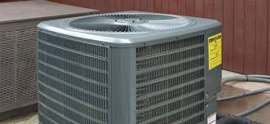
A Solution: Peak Time Savings
Cut your power use on high demand days – even if not home!
Get a small reward
Easy to sign up
No risk to customer
For “everyone”
Helps environment

Slide 23
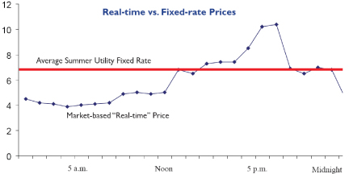
Another Solution: Hourly Pricing
Customers buy power at variable wholesale rates
Shift – reduce – save money
Rates usually less than 7 cents/kW-hr

Slide 24
Making Solar Energy Work
Sun shines in daytime – usually!!!
Buy off the grid
Net metering credit for sending to the grid

Slide 25
Solar Power and Hourly Pricing

Slide 26
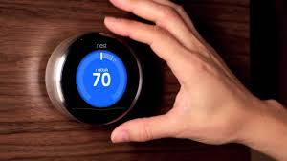
Other Tricks to Save Money
Change furnace filters
Remove window screens
Upgrade the AC
Smart thermostats
Air seal the attic
Upgrade light bulbs

Slide 27
Wonderful World of LED Lighting

Slide 29
Takeaways Regarding the Smart Grid
Reliability and information
Save money with hourly pricing
Save the environment through conservation
Cool new technologies
Enables clean energy revolution

Slide 30
The end!
Jeff@scarce.org
Bev@scarce.org
Molly.Gardner09@gmail.com

